Slide 1
This Lecture is supported by the IEEE Electronics Packaging Society’s Distinguished Lecturer Program
eps.ieee.org

Slide 2
IEEE Electronics Packaging Society (EPS)
Awards
EPS Awards Program recognizes contributions to the profession, industry & the Society through a comprehensive set of awards and recognitions.
Membership
>2500+ current members
53% in the Americas
30 % in Asia
17 % in Europe
Technical Committees
Education
Materials & Processes
High Density Substrates & Boards
Electrical Design, Modeling & Simulation
Thermal & Mechanical
Emerging Technology
Nanotechnology
Power & Energy
RF & Thz Technologies
Photonics -- Communication, Sensing, Lighting
3D/TSV
Reliability
Test
Rao Tummala Packaging Award + 7 EPS Awards & PhD Fellowship
59
Chapters
IEEE and the EPS offer a wide range of learning, career enhancement, and employment opportunities within the engineering sciences, research, and other technology areas.
21 Unique
17 Joint
21 Student
Education, eLearning, and much more for career enhance-ment
Electronic Packaging Society → Overview
Technical Committees
Publications
650k Trans/Conf Downloads/yr.
Conferences
EPS sponsors conferences around the world. EPS Members can access EPS conference proceedings and journal papers for FREE through the EPS Digital Member Library @ IEEE Xplore®
IEEE EPS Transactions on CPMT
EPS Newsletter - IEEE Electronics Packaging Society
25 Conferences / Workshops supported/year
“Emerging technologies—such as AI, 5G, edge, cloud, and data center, autonomous vehicles and wearable technology hold great promise for improving the lives of individuals across the globe,” (HIR)
Notes:
This is a graphic I use to highlight key items about EPS. Starting with membership and going clockwise I will describe EPS. We currently have 2420 members with 53% located in Regions 1-7 and the remaining 47% in regions 8 and 10. In total there are 21 unique, 17 joint, and 21 student chapters.
Next there are 12 technical Committees focused on global subject matters. I have listed them here for your review. As I mentioned on the previous chart, we sponsor 25 + conferences a year. In Nov 2022 EPS launched the EPS Members Digital Library. This is available to all EPS members “free of charge”. This covers conference proceedings, old to new and much, much more. If you think about it this digital library access is certainly a great EPS membership benefit.
EPS issues peer reviewed Transactions on CPMT, newsletters, and Xplore.
EPS has a solid education program and a broad-based awards program. I will discuss more on subsequent charts.

Slide 3
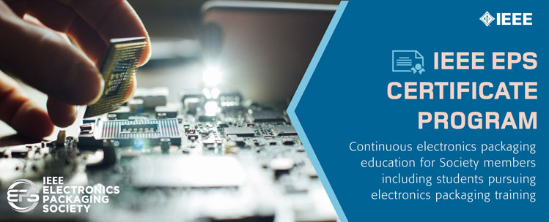
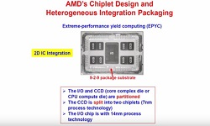
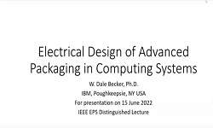
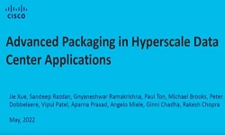
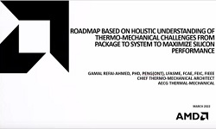
Highlights of the EPS Education Programs
EPS Certificate Program
EPS Achievement Certificate
EPS Distinguished Achievement Certificate for Technical Leadership and Expertise
EPS Distinguished Achievement Certificate for Professional Engagement and Service
Resource Center (Resource Center IEEE EPS)
Heterogeneous Integration Roadmap: Presentations, 24 Technology Specific Chapters
Featured Papers/ Reports
EPS Newsletters
> 100 Technical Webinars
Education Materials
EPS Resource Center at a Glance
EPS Distinguished Lecturer (DL)
34 DL’s covering a multitude of topics
Talks at Chapters/Universities & Conferences
(EPS VP, Education - Eric Perfecto)
https://eps.ieee.org/education.html/
Notes:
As mentioned, the Education Program has grown significantly in the past 10 years. EPS offers a full range of resources that can be used by the new graduate, the young professional (0 to 5 years career), the mid-career engineer, as well as the seasoned lifetime career. This consists of webinars (technical and personal development), specific packaging topics found in featured papers and reports. HIR (Heterogenous Integration Roadmap). When you get a chance, access the EPS Resource Center to learn how to develop and enhance your career.
In the early 2000’s EPS initiated their Distinguished Lecturers (DLs). These 33 subject matter experts are made available to chapter meetings, workshops, universities, and conferences. There are DL term limits that ensure that our DL’s are top notch in their field of expertise.
The EPS has a multiple certificate program that members can participate in. These are for an individuals to apply for and by doing so document his/her achievements both in their worklife and personal life.
To date 38 certificates have been issued for all but regions 4 and 9. Two distinguished technical leadership certificates and one distinguished for Professional Engagement.
This is a lot to think about and certainly a EPS Members benefit.

Slide 4
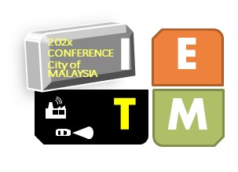
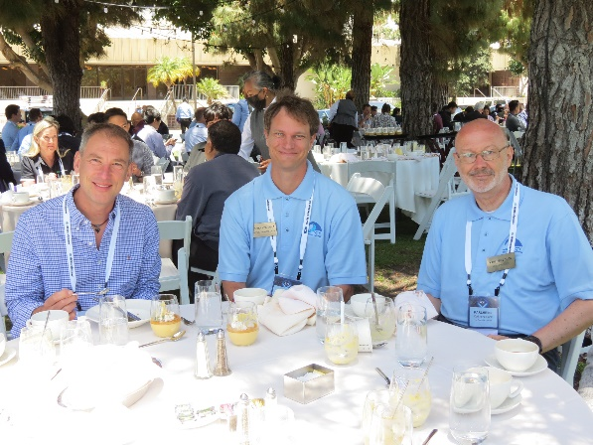
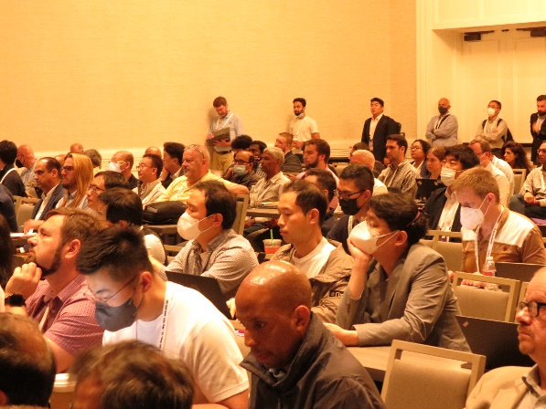
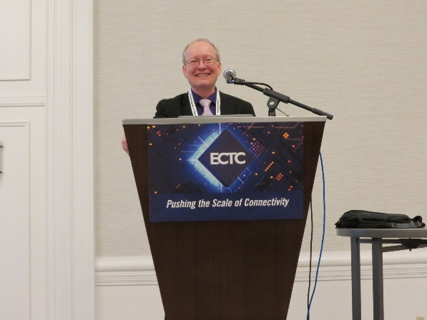
25+ Conferences / Workshops + CPMT Transactions
North America
Asia
Europe
many other
IEEE CPMT Symposium
Japan
EPS Flagship Conferences
International Conference Electronic Packaging Technology
Design and Technology of Modern Electronic Systems
All papers are available free to EPS members, visit: https://ieeexplore.ieee.org/Xplore/home.jsp
Notes:
WOW! 25+ conferences. When you think about it, for a small society such as ours we sure have a lot of information to disseminate to our packaging industry.
Let's start with why we are here today. As mentioned, EPS sponsors more that 25+ conferences a year. Key to EPS is the 3 Flagship conferences: ECTC- North America, EPTC – Asia, and ESTC – Europe. For the 1st time in 2022 EPS cosponsored both a workshop in Bangalore, India with the India Electronics and Semiconductor Association (IESA) as well as DTMES (Design and Technology of Modern Electronic Systems. There are so many others to mention but we don’t have enough time or space to highlight all of them.

Slide 5
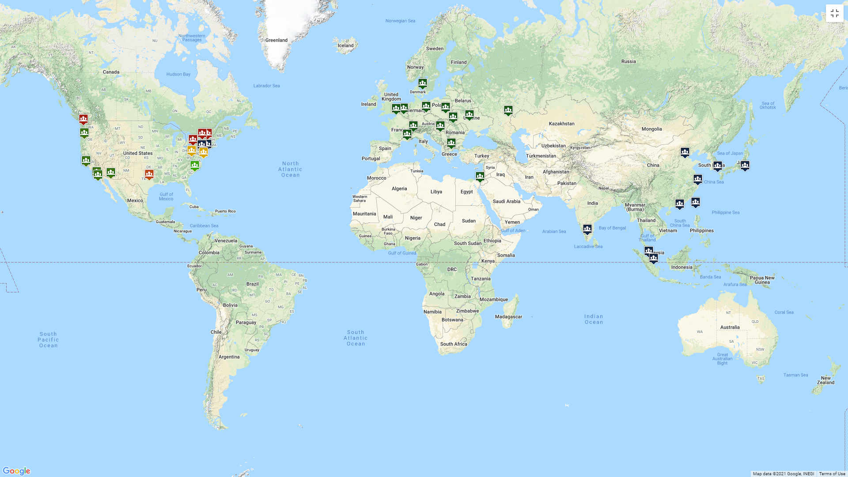
40+ Chapters Around the World
Number of Chapters
Region 1: 2
Region 2: 3
Region 3: 1
Region 4: 1
Region 5: 1
Region 6: 6
Region 7: 4
Region 8: 13
Region 9: 0
Region 10: 9
EPS Chapters: 20
Joint Chapters: 20
Join an EPS Chapter near you !

Slide 6
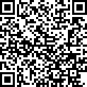
Earn PDHs for attending DL talks
RECEIVE CREDIT FOR PROFESSIONAL DEVELOPMENT HOURS
Complete the survey using the QR code below and you can receive 1 Professional Development Hour (PDH) for attending an EPS Distinguished Lecture

