Slide 1
This Presentation is supported by the IEEE Electronics Packaging Society’s Distinguished Lecturer Program
eps.ieee.org

Slide 2






IEEE at a Glance
Our Global Reach
400,000+
Members
46
Technical Societies and Councils
160+
Countries
Our Technical Breadth
1,800+
Annual Conferences
5,000,000+
Technical Documents
200+
Top-cited Periodicals

Slide 3
Electronics Packaging Society
A Global Society with…
…Chapters, members, constituents spanning the world
38 Chapters located in US, Asia/Pacific, Europe
12 Technical Committees
2200+ members worldwide
650k Trans/Conf Downloads/yr
4500 attendees at 25 Conferences/Workshops
Packaging Field + 6 EPS Awards + PhD Fellowship
Peer Reviewed Transactions

Slide 4

Russia
Russia
Shanghai
Singapore
Switzerland
Taipei
Ukraine (2)
United Kingdom & Republic of Ireland
United States (12)
EPS Local Chapters
Bangalore
Beijing
Benelux
Bulgaria
Canada (4)
France
Germany
Hong Kong
Hungary/Romania
Israel
Korea
Japan
Malaysia
Nordic
(Sweden, Denmark, Finland, Norway, Estonia, Iceland)
Poland

Slide 5
EPS Technical Committees
Materials & Processes
  Chair: Bing Dang
High Density Substrates & Boards
  Chair: Yasumitsu Orii
Electrical Design, Modeling & Simulation
  Chair: Stefano Grivet-Talocia
Thermal & Mechanical
  Chair: Ankur Jain
Emerging Technology
  Chair: Benson Chan
Nanotechnology
  Chairs: Americas: Raj M. Pulugurtha, Europe: Attila Bonyar, Asia: Jian Cai
Power & Energy
  Chair: Patrick McCluskey
RF & Thz Technologies
  Chair: Manos Tentzeris,
Photonics - Communication, Sensing, Lighting
  Chair: Gnyaneshwar Ramakrishna
3D/TSV
  Chair: Peter Ramm
Reliability
  Chair: Przemek Gromala
Test
  Chair: Pooya Tadayon

Slide 6
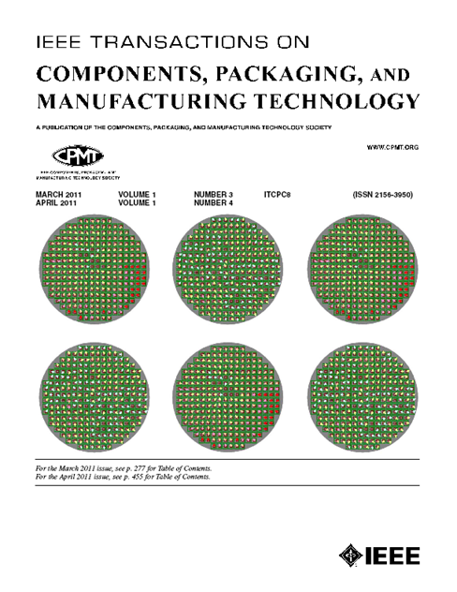
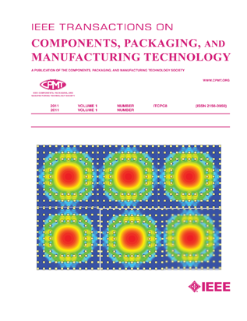
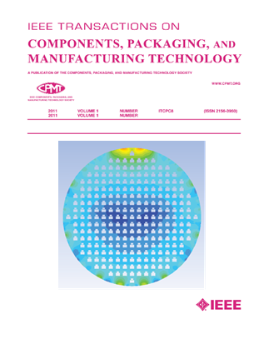
Peer-Reviewed Technical Publication
Transactions on CPMT
- 595 submissions (2020)
240 papers published
Impact Factor: ~ 1.7 (2020)
Xplore Usage: 40,000+
VP Publications – Dr. Ravi Mahajan, Intel
CPMT Transactions, Monthly eNewsletter, and
Bi-Annual printed Newsletter

Slide 7
Financial Sponsor
ECTC
EDAPS
HOLM
ICSJ
ITherm
SPI
3DIC
Co Sponsor
EPEPS
EPTC
ESTC
IEMT
EMAP
IWASI
IWIPP
Technical
ASMC
DTIP
EDPS
EMPC
EOS/ESD
EuroSimE
ICEPT
3D-PEIM
Sponsor
IMPACT
ISSE
MID
NordPac
Pan Pacific
SEMI THERM
THERMINIC

Slide 8
EPS Awards & Recognition
IEEE Electronics Packaging Award
(IEEE Technical Field Award)
Outstanding Sustained Technical Contribution Award
Electronics Manufacturing Technology
David Feldman Outstanding Contribution
Exceptional Technical Achievement
Outstanding Young Engineer
Transactions Best Papers
Regional Contributions
PhD Fellowship

